Slide 1
Analysis and Mitigation of Radiation Induced Errors In Modern Circuits
Dissertation Proposal
Adam Watkins
Advisor: Spyros Tragoudas

Slide 2
Outline
Introduction
Soft Error Tolerant Latches
Soft Error Simulators
Transient Pulse Shape Approximation
Conclusion

Slide 3
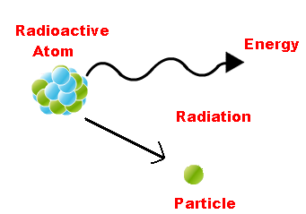
Introduction
Proposed work entails the analysis of radiation induced errors in circuits
Radiation error occurs when a particle strikes a transistor
Particles come from space or packaging
Many types of particles
Charged particles (Electrons/Protons)
Neutrons
Alpha Particles
Heavy Ions
A example of a radiation particle leaving an atom [1].
[1] http://chemistry.tutorvista.com/nuclear-chemistry/radioactivity.html

Slide 4
Introduction (Cont.)
A radiation particle may create 2 types of error
Soft Error – the error only causes temporary damage to the device
Hard Error – the device is permanently damaged
This work focuses on soft errors
Soft Errors
Single Event Transient (SET) – temporary voltage pulse
Single Event Upset (SEU) – a memory element loses is value or a SET is stored in a latch
Soft or Hard Error
Single Event Latch up (SEL) – a potentially destructive event in which a particle creates a parasitic NPNP bipolar device
Specifically interested in SETs and SEUs

Slide 5
Radiation Inducing a Soft Error
The radiation exists as a high energy charged particle
The particle travels through the transistor ionizing atoms -generating electron-hole pairs
Causes a break down of the diffusion region in a blocking transistor allowing current to flow
Generates a voltage pulse
May upset the stored data if it occurred in memory
Model of the transistor strike

Slide 6
Outline
Introduction
Soft Error Tolerant Latches
Soft Error Simulators
Transient Pulse Shape Approximation
Conclusion

Slide 7
Soft Error Tolerant Latches
In this section existing error tolerant latches are investigated
The latches can tolerate 2 types of soft error
Single Node Upset (SNU) – only a single node is struck by a particle
Double Node Upset (DNU) – two nodes are struck by a particle
Some of the latches are suitable for clock gating
Clock Gating – the clock is set to a stable value to save power

Slide 8
SEU Tolerant Latch Designs
Most common SEU tolerant latch design is the DICE latch
Uses 4 cross-coupled elements
Other designs use Muller c-elements to vote on the output
These designs are only capable of tolerating a single error
DICE Latch [1]
Muller c-element [2]
[1] T. Calin et al, Upset Hardened Memory Design for Submicron CMOS Technology, 1996
[2] D. E. Muller, Theory of asynchronous circuits, 1955

Slide 9
The Double Node Upset (DNU)
DNU - single particle upsets multiple transistors
Particle generates electron-hole pairs in two transistors simultaneously
May lead to the upset of two separate nodes in a latch
Latch will change value if not hardened
Example of a DNU on a latch

Slide 10
Existing DNU Tolerant Designs
First DNU tolerant design proposed is the DNCS
Uses two DICE latches and a Muller c-element
Another design is the interception latch
Uses c-elements connected in a loop
Existing most efficient design is the HSMUF
Uses an extended DICE element with nodes connected to a Muller c-element
These designs move to a high impedance state after a DNU which limits their applicability

Slide 11
Clock Gating in DNU Tolerant Latches
Clock gating – shut off the clock to save power
Latches with high impedance states after a DNU may lose their value if gated
Previously a weak keeper on the output used to hold the value for clock gating
Has a high cost in power, delay and area
C-element with a weak keeper on the output

Slide 12
Proposed Work
Existing latch designs can tolerate both SEUs and DNUs
Many of these designs do not function well when clock gating is used
Use of a weak keeper leads to high delay, power and area costs
It is proposed to develop a DNU tolerant latch suitable for clock gating
The design will not use a weak keeper
Reliability will be ensured through recovery of all nodes after error

Slide 13
Outline
Introduction
Soft Error Tolerant Latches
Soft Error Simulators
Transient Pulse Shape Approximation
Conclusion

Slide 14
Soft Error Simulation
This section focuses on discussing current soft error simulators
They calculate the soft error rate of a circuit
Has proven to be a difficult problem
Existing simulators focus on accurate estimation of the logical effect
Many of them suffer from memory blow up or excessive simulation times

Slide 15
Soft Error Rate
Goal of soft error simulation is to calculate the soft error rate (SER)
SER = P(e) * R_{eff} * P_{eff} * A
P(e) – probability of an error on an output
R_{eff} - effective particle concentration
P_{eff} - probability of particle hitting sensitive region
A – area of the circuit
P(e) is difficult to attain due to computational complexity
Can be attained empirically
Requires testing at a particle accelerator
The circuit must be fabricated
Leads to a need for accurate and fast simulators

Slide 16
Evaluation of Combinational Circuits
Increasing error rates has led to increased errors in combinational circuits
Implies that simulators must consider the error in these circuits
Difficult due to 3 masking factors
Electrical Masking – pulse is attenuated by the gate’s transfer function
Logical Masking – the “1s” and “0s” from the input pattern mask the pulse
Temporal Masking – pulse does not meet set up and hold time requirements

Slide 17
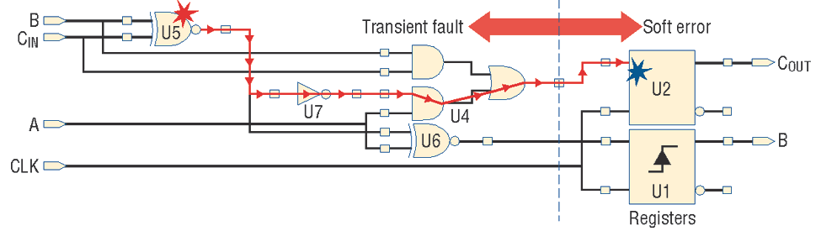
Soft Error Simulation
Soft error simulation consists of 3 parts
Pulse Injection – an equation is used to relate the injected charge to a pulse
Pulse Propagation – pulse is propagated through the circuit
Latching Evaluation – it is determined at the output device if the pulse is stored
Borrowed From: Mitra et al, Robust System Design with Built-In Soft-Error Resilience, 2005

Slide 18
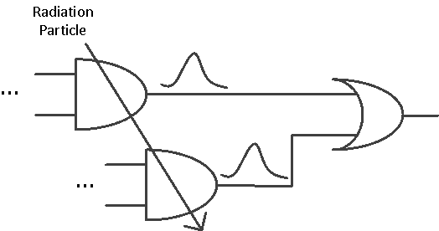
Multiple Event Transients
Multiple Event Transient (MET) – a single particle strikes two or more cells causing multiple transients
Further complicates the problem due to pulse merging
Logical masking
The correlation between the propagation functions must be considered
Electrical masking
Multiple pulses may arrive at a gate simultaneously
A MET generated within a circuit

Slide 19
Existing Soft Error Simulators
Soft Error Rate Analysis (SERA) Methodology
Estimates the SER through probabilistic arguments
Relies on the use of random input patterns
Uses simple electrical masking models
Does not consider convergent pulses
Correlation Error Propagation (CEP)
Determines the logical masking effect using the correlation coefficient methodology (CCM)
CCM – determines the signal probabilities using standard probabilistic arguments with an additional correlation factor
Uses probabilistic models to determine the SER
Simple electrical masking calculation
Considers METs

Slide 20
Existing Soft Error Simulators (Cont.)
Fast Analysis of Soft Error Susceptibility (FASER)
Uses binary decision diagrams (BDDs) for logical masking
Applies partitioning to reduce simulation time
Electrical masking considered using a simple square shape
Multiple events are not considered
Modeling and Reduction of Soft Errors in Combinational Circuits (MARS-C)
Uses BDDs to find logic functions – stored in algebraic decision diagrams (ADDs)
Capable of simulating many pulses concurrently
Only considers pulse width and magnitude for electrical masking
Vulnerable to BDD size blow up
Can consider METs

Slide 21
Proposed Work
Current soft error simulators use inaccurate electrical masking models
They are unable to consider METs accurately
Many of them are susceptible to memory blow up or long execution times
It is proposed to develop a simulator that uses partitioning and BDDs to determine logical masking
Proposed simulator will also use an accurate model for electrical attenuation

Slide 22
Outline
Introduction
Soft Error Tolerant Latches
Soft Error Simulators
Transient Pulse Shape Approximation
Conclusion

Slide 23
Transient Pulse Propagation
This section focuses on estimating the pulse shape in combinational circuits
Accurate pulse shape estimation is important
Most existing pulse approximation methods only consider one pulse arriving on a gate
Additionally most only use simple square or trapezoidal approximation

Slide 24
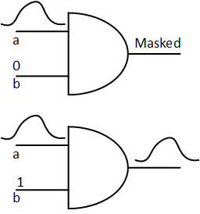
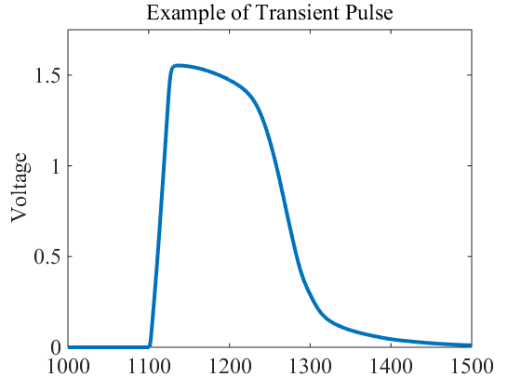
Transient Pulse Propagation (Cont.)
Pulses are generated at a gate
May be propagated to a primary output
If all inputs are non-controlling, it will prop
A standard pulse has linear and non linear parts
Example of a typical transient pulse
Cases for pulse propagation

Slide 25
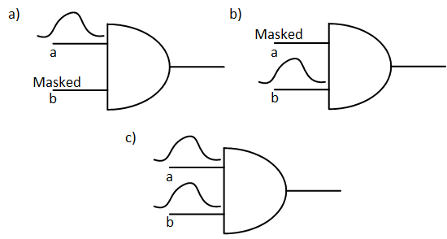
Multiple Event Transients
Increase in the occurrence of METs lead to more pulses
Many pulses may arrive at a gate simultaneously
Creates more propagation cases
Assume two pulses arrive at a AND gate
Leads to 3 cases
Pulse on (a) propagates
Pulse on (b) propagates
Both (a) and (b) propagate
Number of cases increase exponentially
3 propagation cases for a 2 input AND

Slide 26
Existing Pulse Approximation Methods
Simplest is square approximation
Has one parameter – the width
Calculated from the gate delay
Very fast and simple
Not accurate
Can consider METs by superimposing the inputs pulses
Trapezoidal Approximation
Has three parameters – rising slope, falling slope and width
Determined from input pulse parameters
Fast and simple
Does not consider the non-linear parts of the circuit
Not suitable for METs

Slide 27
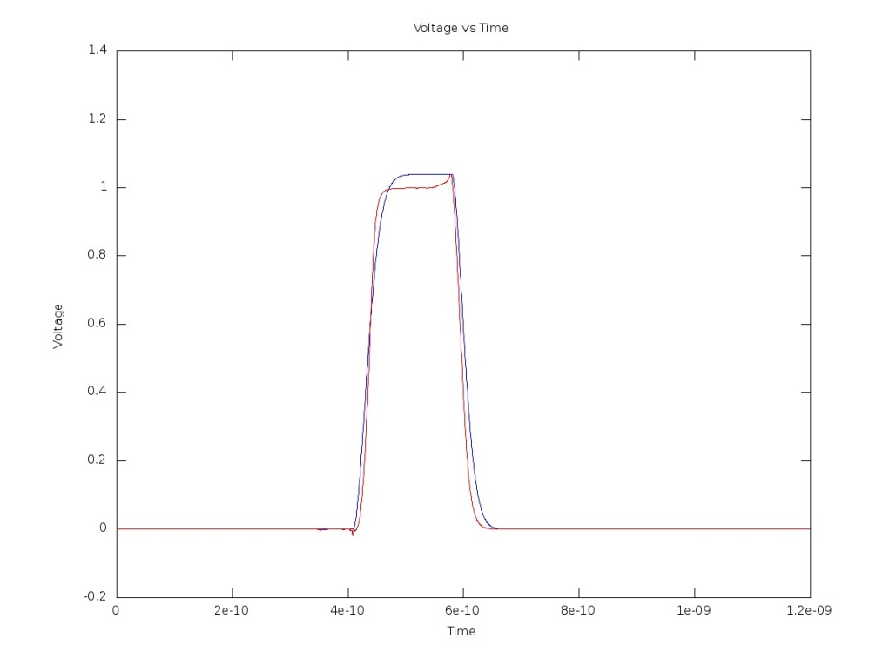
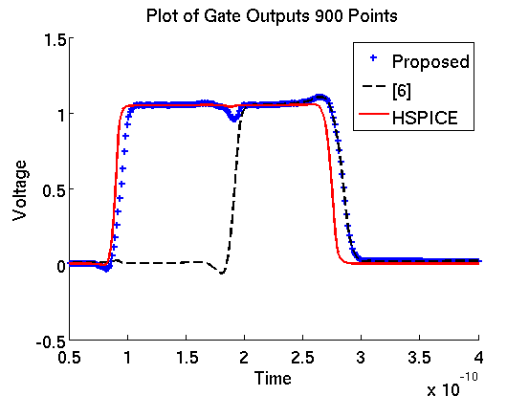
Existing Pulse Approximation Methods
Approximation to Distribution Functions
Can fit to non-linear parts of the pulse shape
Uses pre-characterized parameters
Fast and relatively accurate
Limited in possible pulse shapes
Not suitable for METs
Equivalent Circuit Approximation
Uses an equation derived from equivalent circuit
Iterates through a series of points to form pulse shape
Fits to output pulse using pre-characterized look up tables
Slower but much more accurate
Existing methods do not consider METs
Fitting to Weibull function
Equivalent Circuit Approximation

Slide 28
Proposed Work
Soft error simulation requires accurate approximation of pulse attenuation
Most methods only consider a single pulse
Existing methods for multiple pulses are inaccurate
It is proposed to develop a new approximation method that uses an equivalent circuit
The method can accurately estimate the pulse shape for multiple pulses

Slide 29
Conclusion
Soft errors are a concern in circuit design
New circuit designs and simulation tools are required to handle increasing error rate
For the dissertation the following are proposed
A DNU tolerant latch suitable for clock gating
A simulation tool that calculates the SER using BDDs and an accurate electrical masking model
An accurate equivalent circuit model for determining the pulse shape

